Slide 1
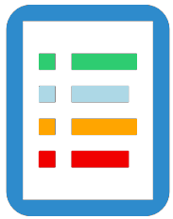
To Do List Application
By Waleed Gudah

Slide 2

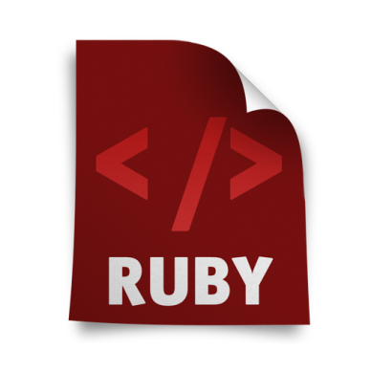

Technologies
Language: Ruby | Framework: Rails | MySQL Rails Gem
Ruby is a dynamic, reflective, object-oriented, general-purpose programming language. | Rails is a web application development framework written in the Ruby language. | MySQL Ruby module is built on top of the MySQL C API, and provides the same functions for Ruby programs that the MySQL C API provides for C programs.

Slide 3

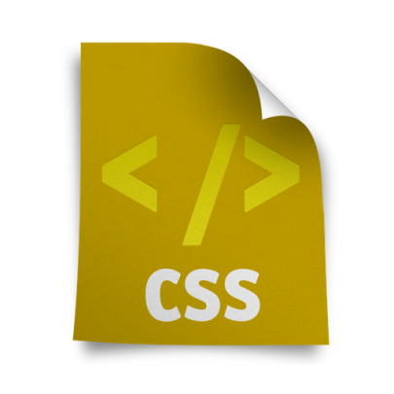

Technologies
HTML | CSS | Twitter Bootstrap
HTML, is the standard markup language used to create web pages. | Cascading Style Sheets (CSS) is a language used for describing the look and formatting of a web page. | Bootstrap is a free and open-source collection It contains HTML- and CSS-based design templates.

Slide 4
Schema Map
Rails automatically maps MySQL types to native Rails classes
MySQL type | Ruby class
TINYINT, SMALLINT, MEDIUMINT, YEAR | Fixnum
INT, BIGINT | Integer
FLOAT, DOUBLE | Float
DECIMAL | String
DATE, DATETIME, TIMESTAMP, TIME | Datetime
CHAR, VARCHAR, BINARY, TINYTEXT, TINYBLOB,MEDIUMBLOB,MEDIUMTEXT, LONGBLOB, LONGTEXT, ENUM, SET, BIT | String
NULL | NilClass

Slide 5
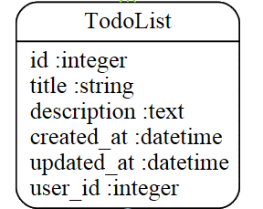
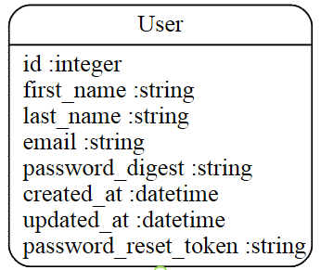
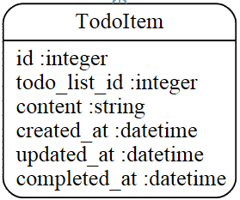
Schema

Slide 6
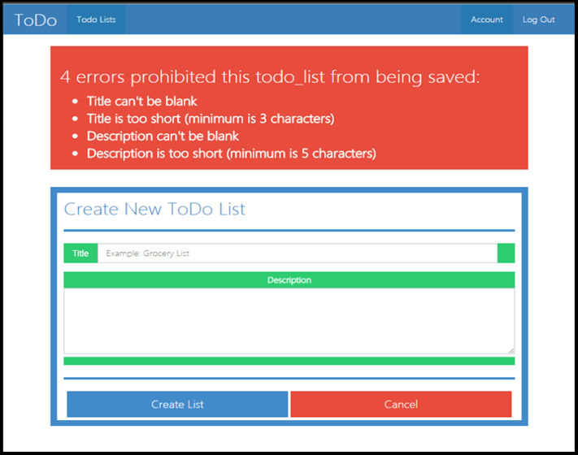
DB Constraint Example

Slide 7
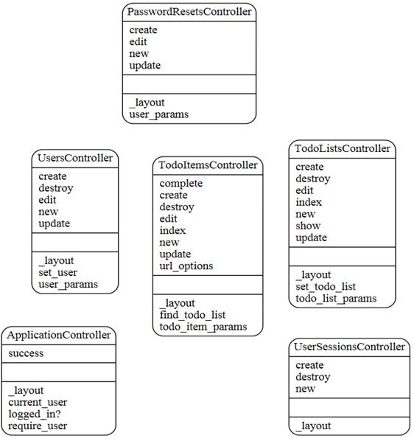
App Control Structure

Slide 8
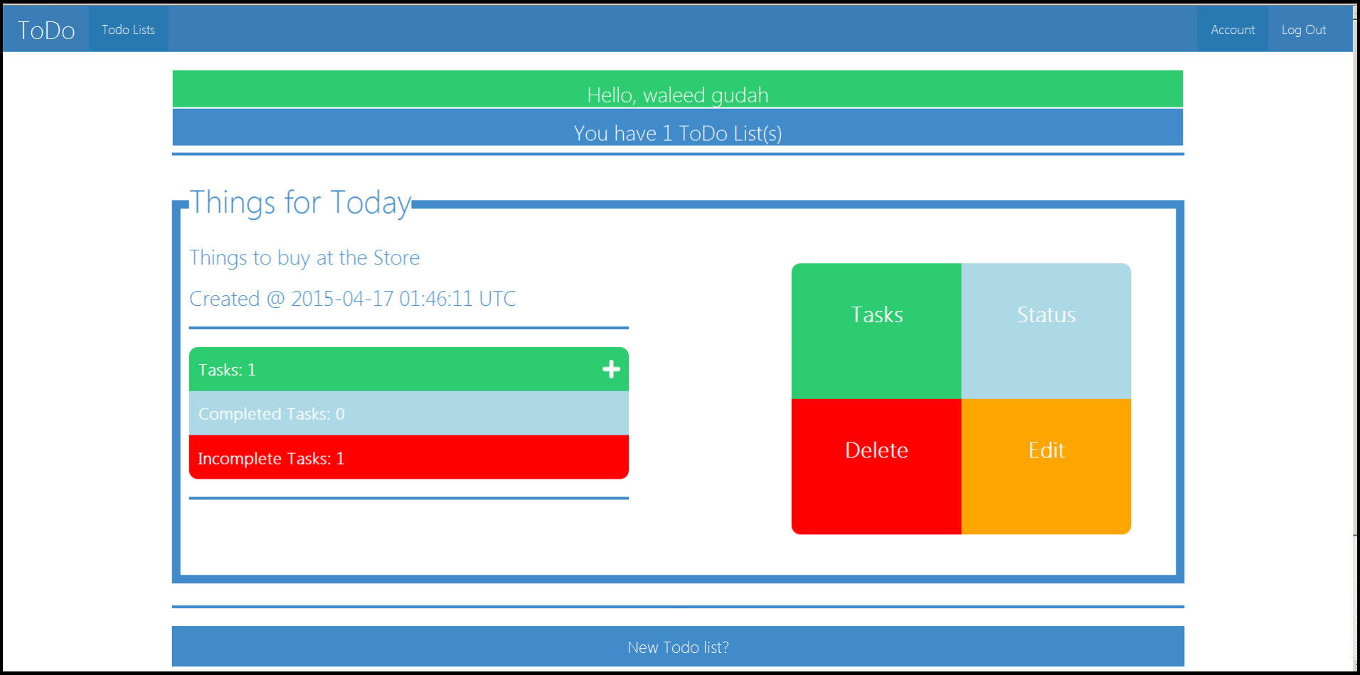
Desktop View

Slide 9
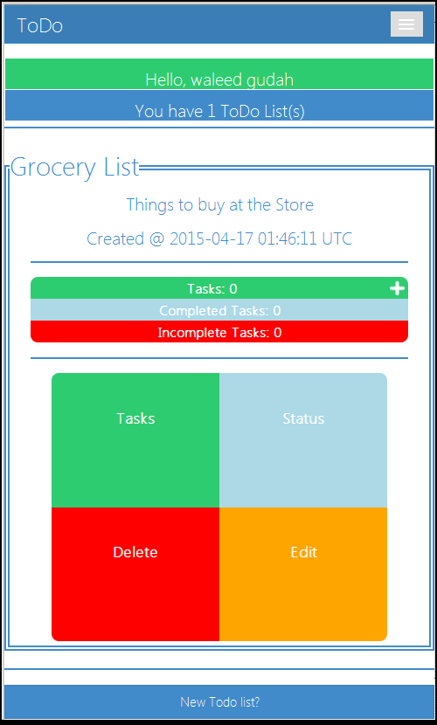
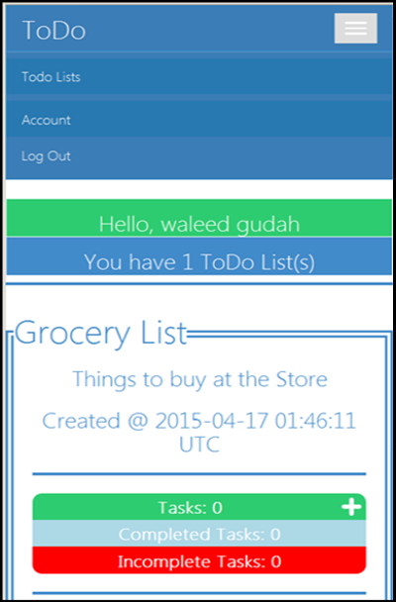
Mobile View

Slide 10
Recorded Demo

